Slide 2
Project Title
Modelling Static and Dynamic Load Balancing Mechanisms in Edge Computing
Project Guide:
Mr. Amrendra Nath Tripathi
Assistant Professor
Department of Virtualization

Slide 3
MINOR 2
Modelling Static and Dynamic Load Balancing Mechanisms in Edge Computing
SAP ID Roll Number Member’s Name Branch
500069818 R110218151 Shubham Bhatnagar CSE-CCVT 500068443 R110218192 Yashvardhan Singh CSE-CCVT 500067853 R110218198 Harsh Upparwal CSE-CCVT
Under the guidance of
Mr. Amrendra Nath Tripathi

Slide 4
Introduction
In this project, as a part of design and implementation we have come with an architecture implementing 6 virtual machines (User, Edge server, Load balancer, 3 Main Servers) and sending tasks between them i.e., from user to edge server and to the main servers if required. Introduction of load balancing comes when the tasks are too much to perform for the edge server, then the edge server is going to transfer the tasks to the main server for computation through the load balancer which will schedule the tasks in such a way that the load on all the three main web servers remain limited.
Edge computing on the other hand will be responsible for enhancing the system performance and minimizing the over burden caused at the cloud (in our case 3 main servers) by bringing down its service to the user edge. It improves the resources utilization efficiency by using the resources already available at the edge of the network. As a result, it decreases the cloud workload, reduces the latency, and enables a new breed of latency-sensitive applications such as the connected vehicles.

Slide 5
Problem Statement
Overloading of servers-leading to server breakdowns : Introducing Load Balancing Algorithms through a Load balancer in between Client and server
Lot of Latency introduced in each task-Leading to lot of delay in response : Introducing Edge Servers with limited but high computational power near to users

Slide 6
Objectives
Objective 1
Studying and grasping the background knowledge related to the Edge Computing, Socket Programming, Client Server Architecture and Load Balancing algorithms:
I. Round Robin Load Balancing
II. Least Connection Load Balancing
III. Resource Based Load Balancing
IV. Previous works related to Load Balancing in Client Server Architecture
Objective 2
Creating all the required Virtual Machines and Setup connection between them.
Objective 3
Implementing computation on Edge node.
Objective 4
Implementing communication between Edge and Server node and performing tasks on Servers using Load Balancing algorithms

Slide 7
Software/ Hardware Requirement
SYSTEM REQUIREMENTS
Hardware Interface:
Minimum RAM requirement for proper functioning is 8 GB.
Required input as well as output devices.
Software Interface:
JDK 15
Eclipse IDE
Virtual Box
Sever ISO image of Linux

Slide 8
Motivation
Cloud computing is a major influencer in the history of edge computing and therefore edge server and computing is something which is new to the market. Edge computing caught our eye due to its involvement in almost every major cloud distributor nowadays like AWS, GCP etc. and also due to its capability to perform computation faster then traditional architecture.
Load balancing on the other hand is something which has been scaled up and used as a major service by almost every architecture nowadays, as it provides extra security and benefits to the servers. So Implementing load balancer for the three servers is the most essential part.

Slide 9
Literature Review
[1] In this paper, the aim is to provide a systematic comparative study of existing load balancing algorithms in cloud computing. It has focused on analyzing various static and dynamic load balancing algorithms with their merits and demerits. It has also addressed the importance of load balancing in the cloud, highlighting the need for dynamic load distribution among the nodes to achieve maximum resource utilization and high user satisfaction ratio.
[2] In this research paper, the various load balancing methods in edge computing are elucidated. A detailed survey of current state-of-the-art load balancing techniques at edge including optimization-based, traffic load-based, heterogeneous, multi-access, joint-load, heuristic, security, allocation, distributed load and the dynamic load-based techniques are explained. It reviewed that dynamic load-based techniques are mostly used in current research whereas CloudSim is a very widely used toolset in the existing research to perform output simulation.

Slide 10
Research Methodology
Research and analysis
We will gain information about Edge Computing, Socket Programming, Client Server Architecture and Load Balancing algorithms
Design
Here we will create pseudo code and understand the data flow of the code we will implement.
Implementation
In this phase we will implement communication between nodes and send computation workloads to edge and server nodes
Testing:
Test the algorithms against different sizes of workloads and different parameters and finally compare their complexities.

Slide 11
Logic Code for Load Balancing Algorithms
RoundRobin(Task)
{
if(Server1=Server2=Server3)
Assign Task to Server 1
if(Server1>Server2)
Assign task to Server 2
if(Server2>Server3)
Assign task to Server 3
}
Task= Task forwarded by Edge Server to Load Balancer
Server1, Server2, Server3= Counter Value i.e, initially 0
Dynamic/ResourceBased(Task)
{
Minimum(Server1,Server2,Server3)
Assign task to minimum
}
Task= Task forwarded by Edge Server to Load Balancer
Server1, Server2, Server3= Amount of Workload on Server

Slide 12
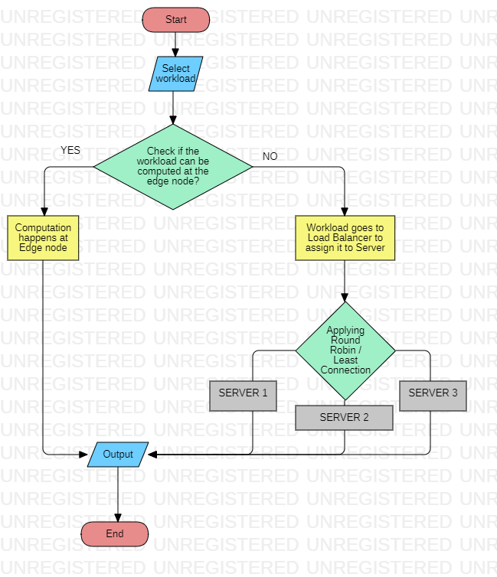
FLOWCHART

Slide 13
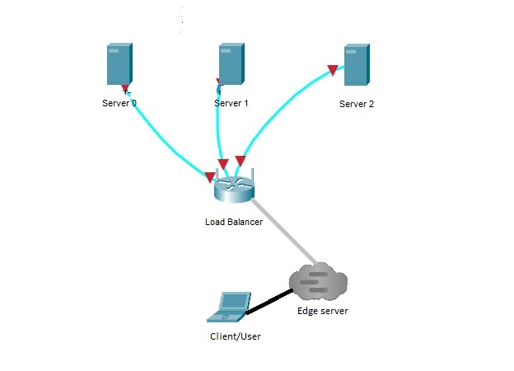
Reference Architecture

Slide 14
References
● [1] T. Deepa, Dr. Dhanaraj Cheelu, “A Comparative Study of Static and Dynamic Load Balancing Algorithms in Cloud Computing” in International Conference on Energy, Communication, Data Analytics and Soft Computing, pp, August 2017
LINK:https://www.researchgate.net/publication/325981627_A_comparative_study_of_static_and_dynamic_load_balancing_algorithms_in_cloud_computing
● [2] Harikrishna Pydi, Ganesh Neelakanta Iyer, “Analytical Review and Study on Load Balancing in Edge Computing Platform” in Fourth International Conference on Computing Methodologies and Communication, pp, 11-13 March 2020
LINK : https://ieeexplore.ieee.org/abstract/document/9076553
● [3] Supriya P Belkar, Vidya Handur, “Comparative Study of Static Load Balancing Algorithms in Distributed System Using CloudSim” in International Journal of Advanced Research in Basic Engineering Sciences and Technology (IJARBEST), Volume 02, Issue 10 (October 2013)
LINK:https://www.ijert.org/comparative-study-of-load-balancing-algorithms-in-cloud-computing-environment
● [4] Karan D. Patel, Tosal M.Bhalodia, “An Efficient Dynamic Load Balancing Algorithm for Virtual Machine in Cloud Computing” in 2019 International Conference on Intelligent Computing and Control Systems (ICCS), pp, 15-17 May 2019
LINK: https://ieeexplore.ieee.org/document/9065292

